Slide 1

UNIT
DAY 25
02
AGAIN AND AGAIN
BUILT TO ORDER
AGENDA
REMINDERS
Phones into The Holding Cell
Open/Closed Laptop
Lab open/accessible
Warm Up
for and range()
Trace It
while
For or While?
The Routine Planner
Close
RECOMMENDED LISTENING:
RAINBOW ROAD – MARIO KART 64
Notes:
Day 25, Unit 2-7: loops. No paper today; the Parsons problem and the trace tables are in the digital lab. Code-along sections are read with hands off keyboards first.

Slide 2

THE WARM UP QUESTION
Recall from Mini A. Answer from memory, no running it yet.
A customer orders 12 snacks. What does it print, and why?
quantity = 12
total = quantity * 2
if quantity >= 5:
total = total - 2
elif quantity >= 10:
total = total - 5
print("Total:", total)
→ Lab Warm Up: answer a) and b) from memory, then run it to check.
Notes:
Recall question on the most common Mini A bug. It also sets up today: Python checks conditions in order, and a loop checks one every single pass.

Slide 3
THE WARM UP ANSWER
It prints Total: 22.
12 >= 5 is True, so that branch runs and the chain stops. The elif is never checked.
→ Lab Warm Up: correct anything you got wrong.
quantity = 12
total = quantity * 2
if quantity >= 10: # check the bigger deal first
total = total - 5
elif quantity >= 5:
total = total - 2
print("Total:", total) # Total: 19
Notes:
Show the fixed order. If Mini A raised other common problems, this is the place for a two-minute recap before moving on.

Slide 4
WHY LOOPS?
A loop repeats a block of code so you do not have to copy and paste it.
Both programs below print the same three lines, but only the bottom one could be easily expanded to print 300 laps
print("Lap 1")
print("Lap 2")
print("Lap 3")
for lap in range(1, 4):
print("Lap", lap)
Notes:
Ask: what would you change in each program to print 300 laps? The copy-and-paste version needs 297 more lines; the loop needs one number changed.

Slide 5
FOR AND RANGE()
for runs the indented block once for each value
  Each pass is an iteration
range(1, 4) will give values of 1, 2, and then 3
  It stops before the second number listed,
    We could say this is including the lower number, and excluding the top one
The loop variable (day) changes on every iteration to increase through the range
for day in range(1, 4):
print("Day", day, "- practise for 20 minutes")
print("Done!")
Notes:
Hands off keyboards: ask what range(1, 4) gives before running it. Most will say 1 to 4. Point out that "Done!" is not indented, so it runs once, after the loop.

Slide 6
TRACE IT
total = 0
for day in range(1, 4):
total = total + 10
print(total)
A trace table has one column per variable and one row per pass.
→ Now: Lab questions 1–2
Step | day | total | Printed
Before | – | 0
Pass 1 | 1 | 10
Pass 2 | 2 | 20
Pass 3 | 3 | 30
After | 3 | 30 | 30
Notes:
Fill this in with the class before revealing it: cover the table and ask for each row. Point out that day keeps its last value (3) after the loop ends.

Slide 7
WHILE
while repeats as long as its condition is True
  It’s like the loop version of an if statement
The condition is checked before every iteration, including the first
minutes = 0
while minutes < 60:
minutes = minutes + 15
print("Studied", minutes, "minutes")
print("Break time!")
Notes:
Run it and ask: why does it stop at 60 and not 75? After the pass that reaches 60, the check 60 < 60 is False, so the loop ends.

Slide 8
WHAT MAKES IT STOP?
Something inside the loop must change the condition
  If nothing does, it is an infinite loop
Stuck? Press Ctrl + C to stop the program. → Now: Lab questions 3–4
minutes = 0
# Never stops: minutes is never changed
while minutes < 60:
print("Studied", minutes, "minutes")
Notes:
Run this live and let it scroll for a few seconds, then stop it with Ctrl + C. Ask what single line would fix it. Lab question 4 is the same bug in a different program.

Slide 9
FOR OR WHILE?
How do I know which loop to use?
for: you know how many times to repeat
while: you repeat until something changes
Which would you use?
Print a 7-day practice plan.
Keep asking for a password until it is right.
Add up the scores from 5 tests.
Keep saving until you have enough for a game.
→ Now: Lab questions 5–6
Notes:
Answers: for, while, for, while. Accept a well-argued while for the first or third, but ask whether you know the number of repeats in advance. The password one is Day 26.

Slide 10
THE ROUTINE PLANNER
Build a planner for someone building a habit: an instrument, reading, a sport.
Ask for the habit, the number of days, day 1 minutes, and how many minutes to add each day
Use a for loop to print one line per day
Keep a running total and print it after the loop
Mark any day of 60 minutes or more with an if
Print a title line before the plan
→ Lab questions 7–8 (the checklist is in Section 4)
Notes:
This is Lab Section 4 and the main task. The most common bug is the running total: either set to 0 inside the loop (so it resets every pass) or added to after the loop (so it only counts the last day).

Slide 11
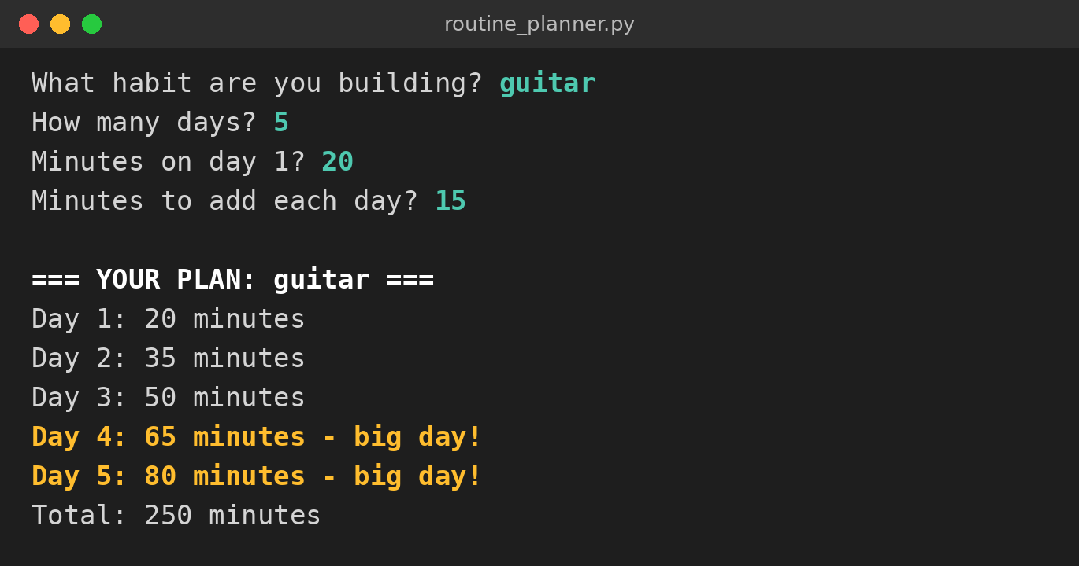
WHAT IT LOOKS LIKE
The for loop printed one line for each of the 5 days.
minutes grew by 15 every pass; total kept adding them up.
→ Where in the code does total have to start at 0?
→ Now: Lab question 7
Notes:
Callout answer: before the loop. Inside the loop it would reset to 0 every pass, and the total would only ever show the last day.

Slide 12
CLOSE
→ Exit question: how many times does this loop run, and what is the last number printed?
for day in range(1, 8):
print(day)
Save your lab as Surname_Lab2-7 and upload it to ManageBac.
→ Lab question 8: trace your own loop before you upload.
Notes:
Exit answer: 7 times, last number 7. range(1, 8) stops before 8. Anyone who says 8 needs another look at slide 5.

Slide 13
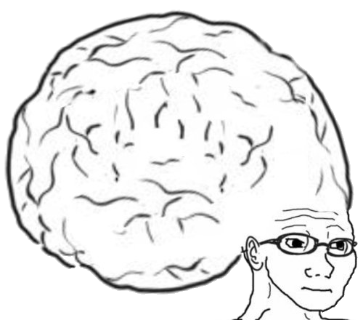
VOCAB TO REMEMBER
Loop - code that repeats
Iteration - one pass through a loop
for loop - repeats once for each value, a set number of times
range() - makes a sequence of numbers, stopping before the end value
while loop - repeats as long as its condition is True
Infinite loop - a loop whose condition never becomes False
Running total - a variable that adds up a value on every pass
Trace table - one column per variable, one row per step
Notes:
Quick-fire: read a definition, students call out the term.

Slide 14
FURTHER READING
Python docs: for statements
Python docs: The range() function
W3Schools: Python For Loops
W3Schools: Python While Loops
Notes:
Share the links on ManageBac for anyone who wants more practice.

